Slide 1


Nicolás Núñez A.
23-06-2025

Slide 2
Outline
Executive Summary
Introduction
Methodology
Results
Conclusion
Appendix

Slide 3
Executive Summary
Summary of methodologies
Summary of all results

Slide 4
Introduction
Project background and context
Problems you want to find answers

Slide 5

Section 1
5

Slide 6
Methodology
Executive Summary
Data collection methodology:
Perform data wrangling
Perform exploratory data analysis (EDA) using visualization and SQL
Perform interactive visual analytics using Folium and Plotly Dash
Perform predictive analysis using classification models
How to build, tune, evaluate classification models
6

Slide 7
Data Collection
The data was collected by making requests to the SpaceX API to retrieve information about past launches. The initial dataset included basic details and various IDs referencing related information (such as rocket, payload, launchpad, and core). Additional API calls were made using these IDs to gather more detailed attributes, including booster version, payload mass, orbit, launch site details (name, longitude, latitude), and landing outcomes. The collected data was then combined and organized into a structured dataframe for further analysis.

Slide 8
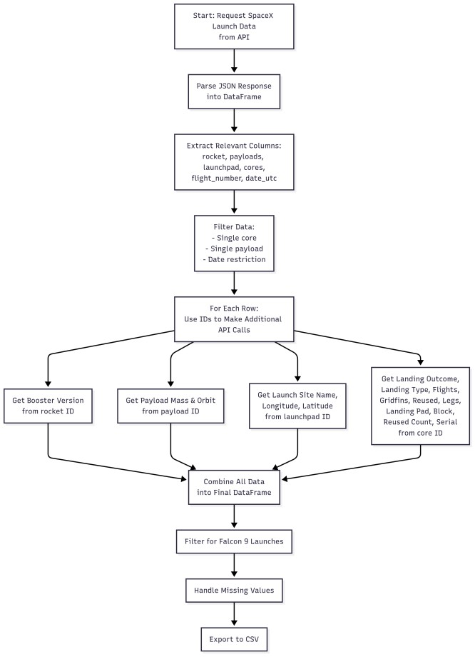
Data Collection – SpaceX API
Collected SpaceX launch data via REST API and loaded it into a DataFrame.
Used IDs to make additional API calls for booster, payload, launch site, and core details.
Combined all information into a structured dataset for analysis.

Slide 9
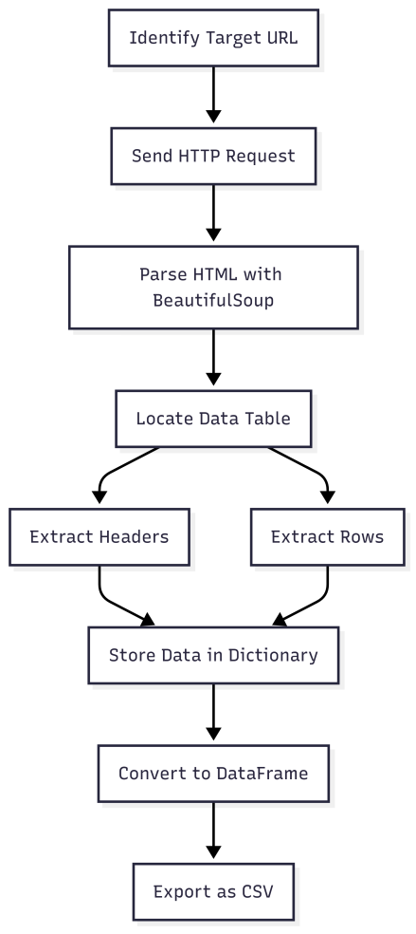
Data Collection - Scraping
Identify target URL, send HTTP request to fetch HTML, parse with BeautifulSoup, locate the data table, extract headers and rows, clean and store data in a dictionary, convert to DataFrame, and export as CSV.
9

Slide 10
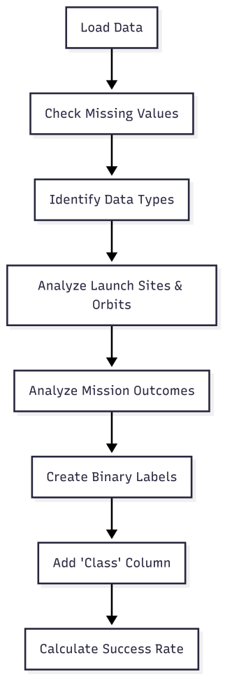
Data Wrangling
Loaded dataset, checked for missing values, and identified column types
Counted launches by site and orbit
Analyzed outcomes, created binary landing label, and calculated success rate
Prepared data for further analysis
Applied-Data-Science-Capstone/labs-jupyter-spacex- Data wrangling.ipynb at main · Zirnit/Applied-Data- Science-Capstone

Slide 11
EDA with Data Visualization
Several charts were plotted to explore relationships between features and Falcon 9 landing outcomes:
Categorical plots showed how flight number, payload mass, launch site, and orbit type relate to landing success.
A bar chart compared average success rates by orbit type.
A line chart displayed yearly trends in launch success.
These visualizations helped identify patterns and correlations to guide feature selection for predictive modeling.

Slide 12
EDA with SQL
Queried unique launch sites and filtered records by site prefix
Aggregated payload mass by customer and booster version
Identified key dates and outcomes for landings
Filtered boosters by landing success and payload range
Counted mission outcomes and found boosters with max payload
Extracted and ranked records by date, outcome, and other criteria

Slide 13
Interactive Map with Folium
Markers, circles, and polylines were added to the map to highlight launch sites and their proximities, with marker clusters for launch outcomes and mouse position for coordinate display. Custom icons were used for labeling.
Used Folium features to visualize launch sites and proximities:
Markers and Circles highlight locations
DivIcon displays custom text labels
PolyLine shows distances to nearby features
MarkerCluster groups outcome markers
MousePosition displays coordinates interactively

Slide 14
Dashboard with Plotly Dash
Summarize what plots/graphs and interactions you have added to a dashboard
Explain why you added those plots and interactions
Add the GitHub URL of your completed Plotly Dash lab, as an external reference and peer-review purpose

Slide 15
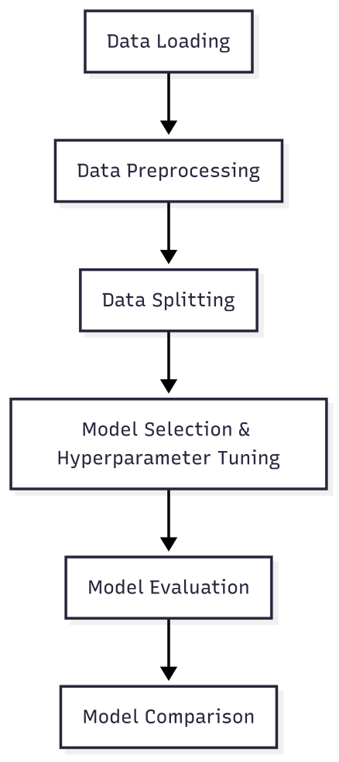
Predictive Analysis (Classification)
Loaded and standardized the data, split it into training and test sets, and built four classification models (Logistic Regression, SVM, Decision Tree, KNN). Used GridSearchCV for hyperparameter tuning, evaluated test accuracy and confusion matrices, and selected the best model based on highest test accuracy.
Applied-Data-Science-Capstone/SpaceX_Machine Learning Prediction_Part_5.ipynb at main · Zirnit/Applied-Data-Science-Capstone

Slide 16
Results
Exploratory Data Analysis Results
Examined the distribution of features and target variable.
Identified class imbalance and key feature correlations.
Visualized feature relationships using pairplots and heatmaps.
Predictive Analysis Results
Compared four classification models: Logistic Regression, SVM, Decision Tree, and KNN.
Evaluated models using accuracy and confusion matrices on the test set.
Identified the best performing model based on highest test accuracy.

Slide 17

Section 2

Slide 18
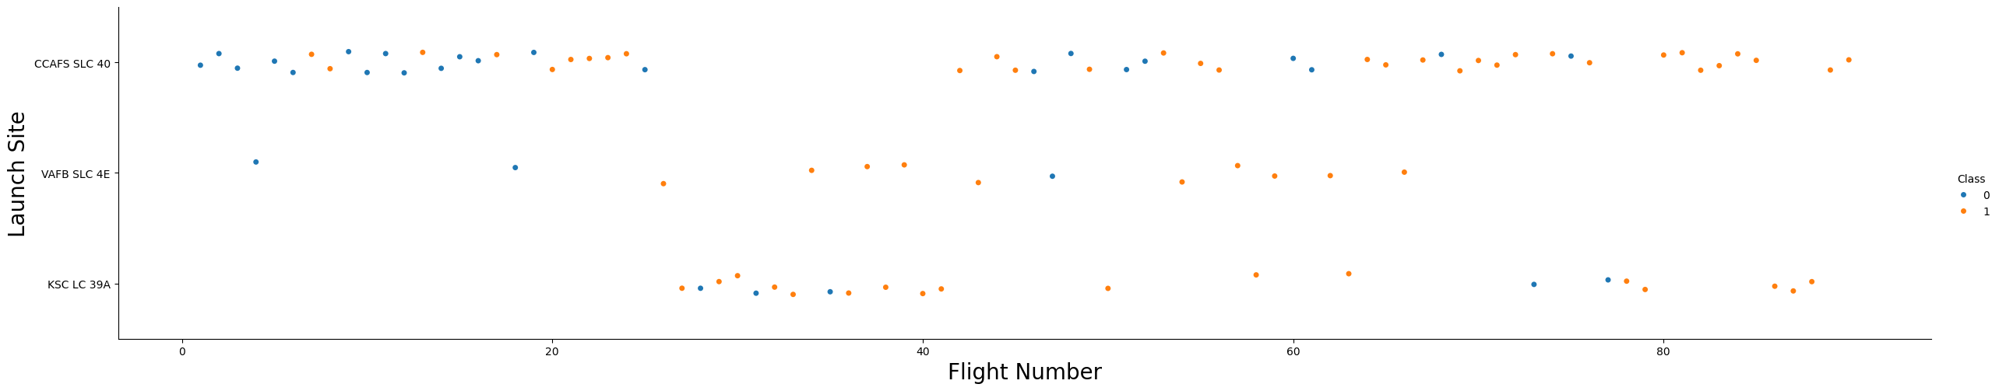
Flight Number vs. Launch Site
The Flight Number vs. Launch Site scatter plot shows that as the number of flights
increases at each site, the likelihood of a successful landing generally improves.
Some launch sites have more frequent launches and higher success rates, while others have fewer launches and more variable outcomes.
This suggests that experience and repeated launches at a site may contribute to better
landing success.
18

Slide 19
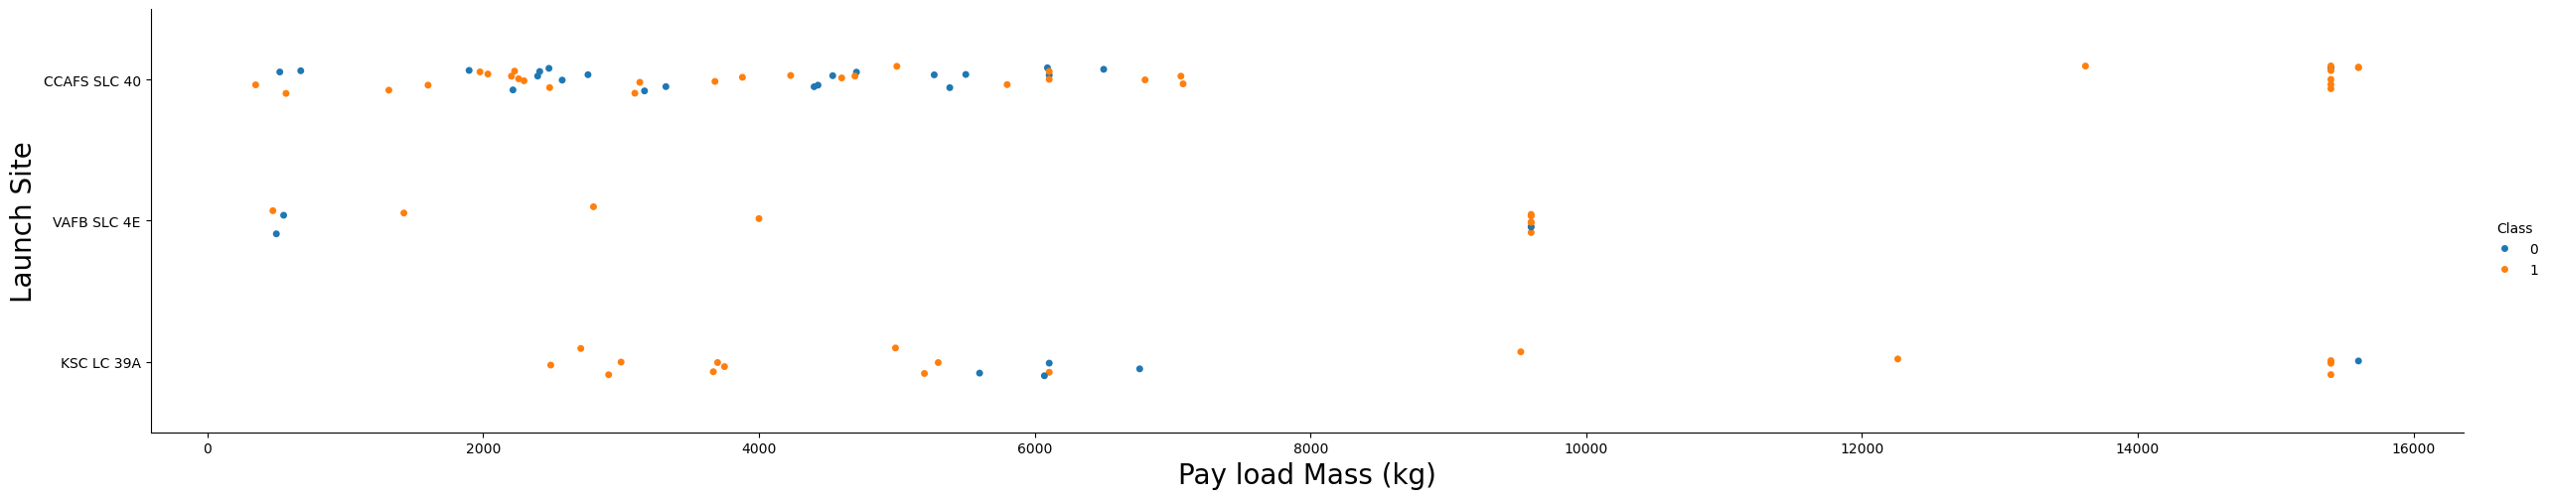
Payload vs. Launch Site
Now if you observe Payload Mass Vs. Launch Site scatter point chart you will find for the VAFB-SLC launchsite there are no rockets launched for heavypayload mass(greater than 10000).

Slide 20
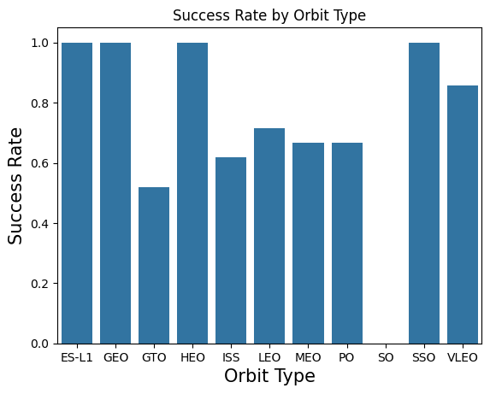
Success Rate vs. Orbit Type
Based on the bar chart, the orbits with the highest success rates are ISS and LEO. These orbits show significantly higher average success rates compared to others, indicating that launches targeting ISS and LEO are more likely to result in successful landings. In contrast, orbits such as GTO and GEO have lower success rates.

Slide 21
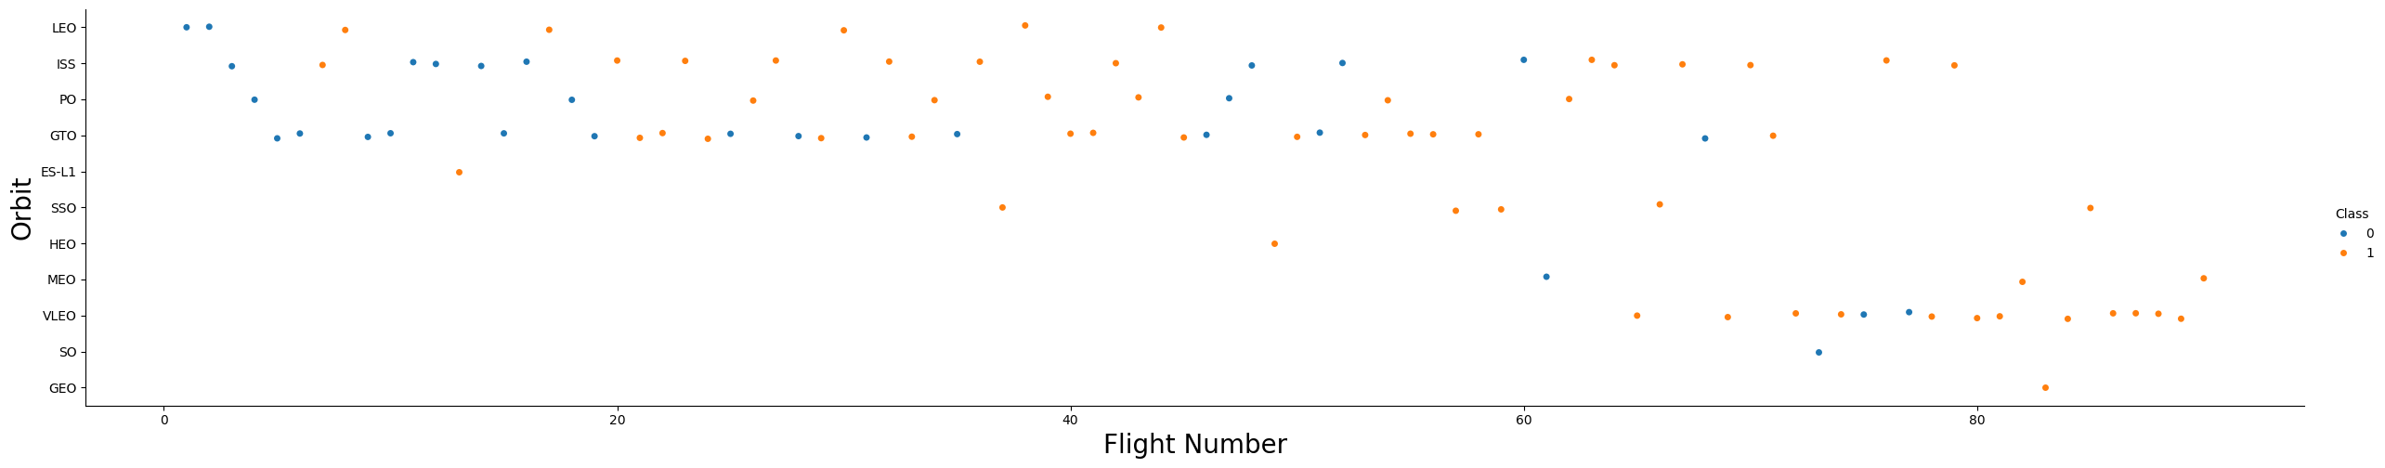
Flight Number vs. Orbit Type
You can observe that in the LEO orbit, success seems to be related to the number of flights. Conversely, in the GTO orbit, there appears to be no relationship between flight number and success.

Slide 22
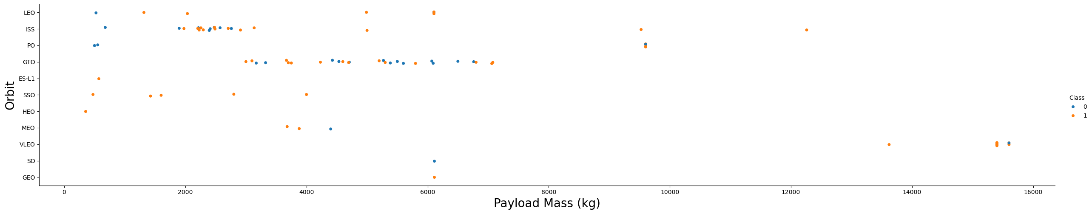
Payload vs. Orbit Type
With heavy payloads the successful landing or positive landing rate are more for Polar,LEO and ISS.
However, for GTO, it's difficult to distinguish between successful and unsuccessful landings as
both outcomes are present.

Slide 23
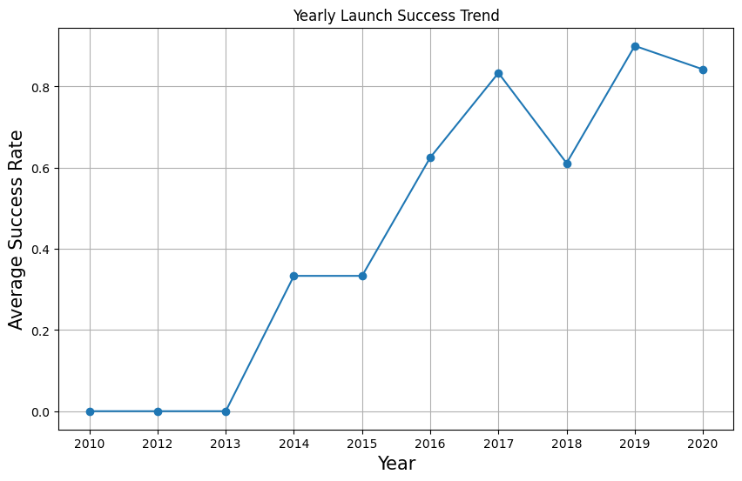
Launch Success Yearly Trend
you can observe that the sucess rate since 2013 kept increasing till 2020

Slide 24
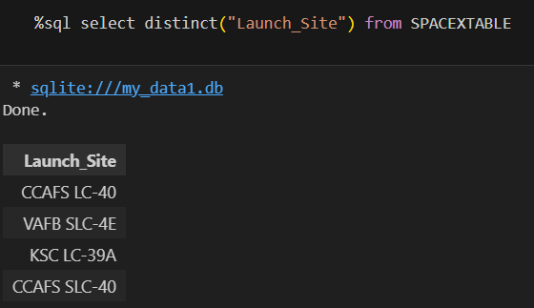
All Launch Site Names

Slide 25
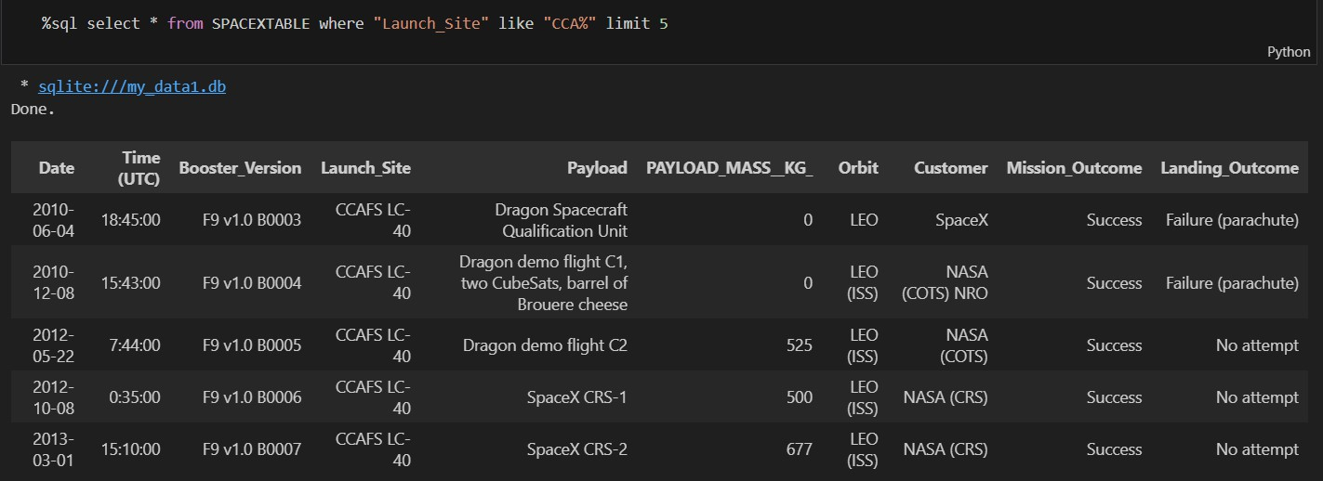
Launch Site Names Begin with 'CCA'

Slide 26
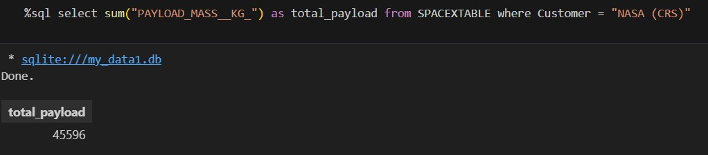
Total Payload Mass

Slide 27
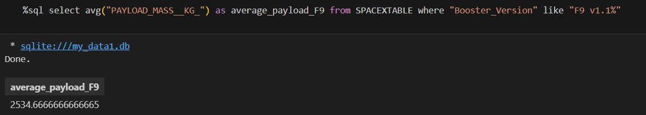
Average Payload Mass by F9 v1.1

Slide 28
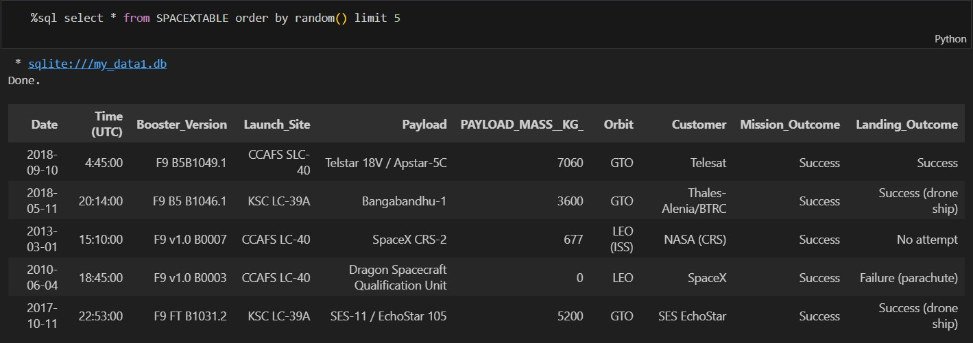
First Successful Ground Landing Date

Slide 29
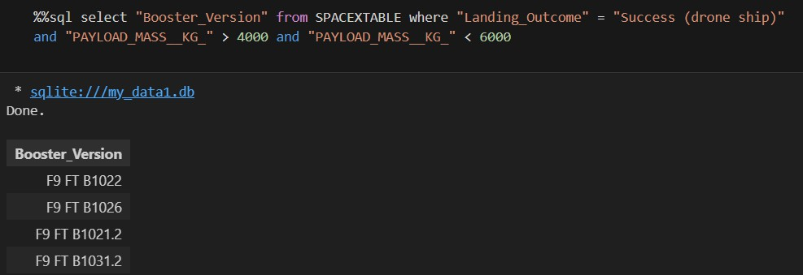
Successful Drone Ship Landing with Payload between 4000 and 6000

Slide 30
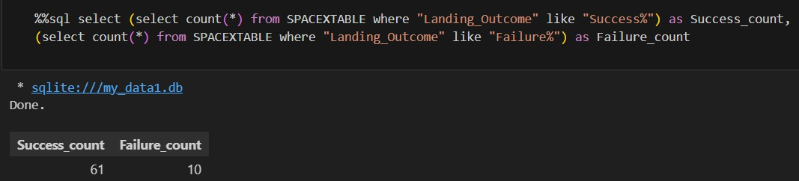
Total Number of Successful and Failure Mission Outcomes

Slide 31
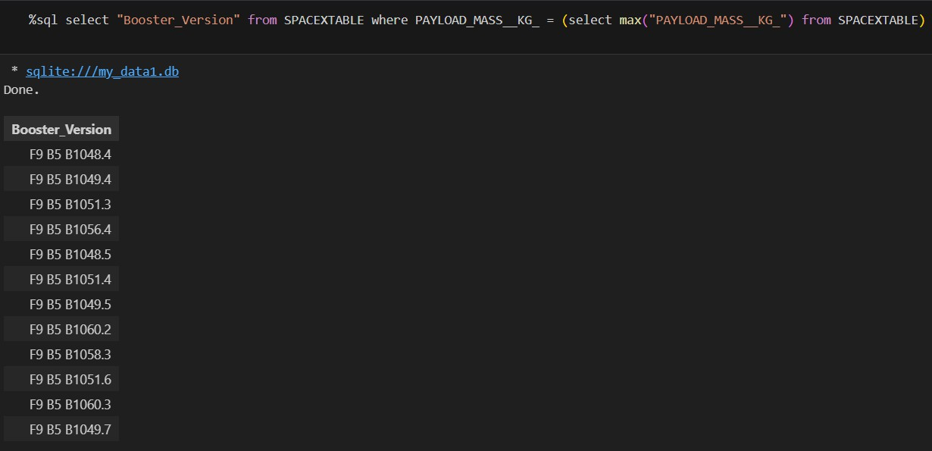
Boosters Carried Maximum Payload

Slide 32
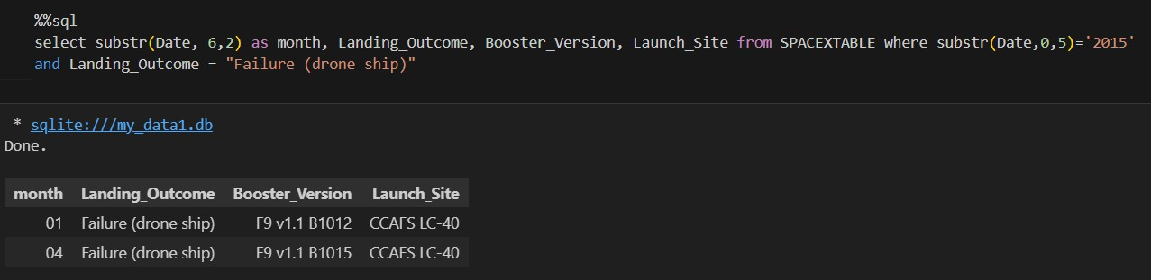
2015 Launch Records

Slide 33
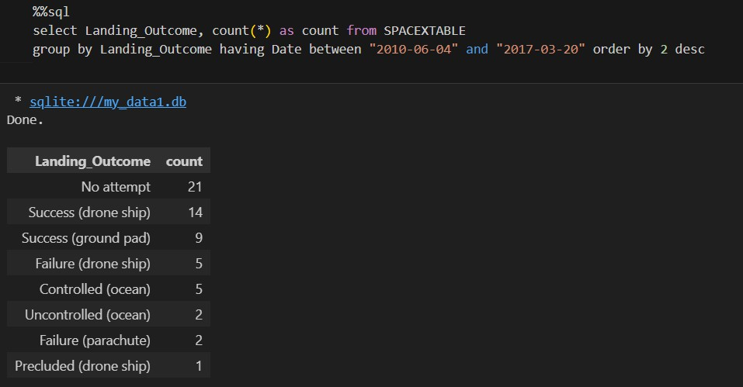
Rank Landing Outcomes Between 2010-06-04 and 2017-03-20

Slide 34

Section 3

Slide 35
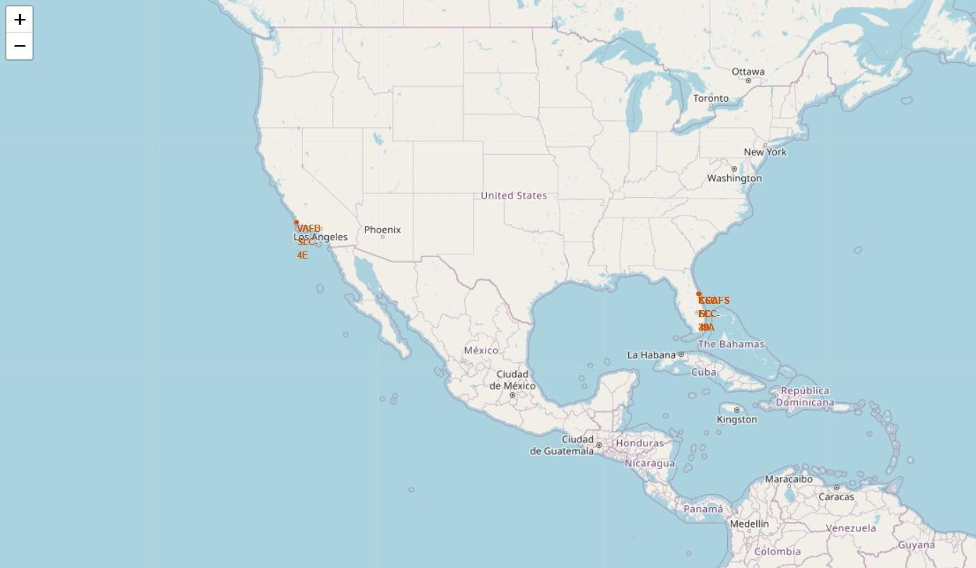
Mark all launch sites on a map

Slide 36
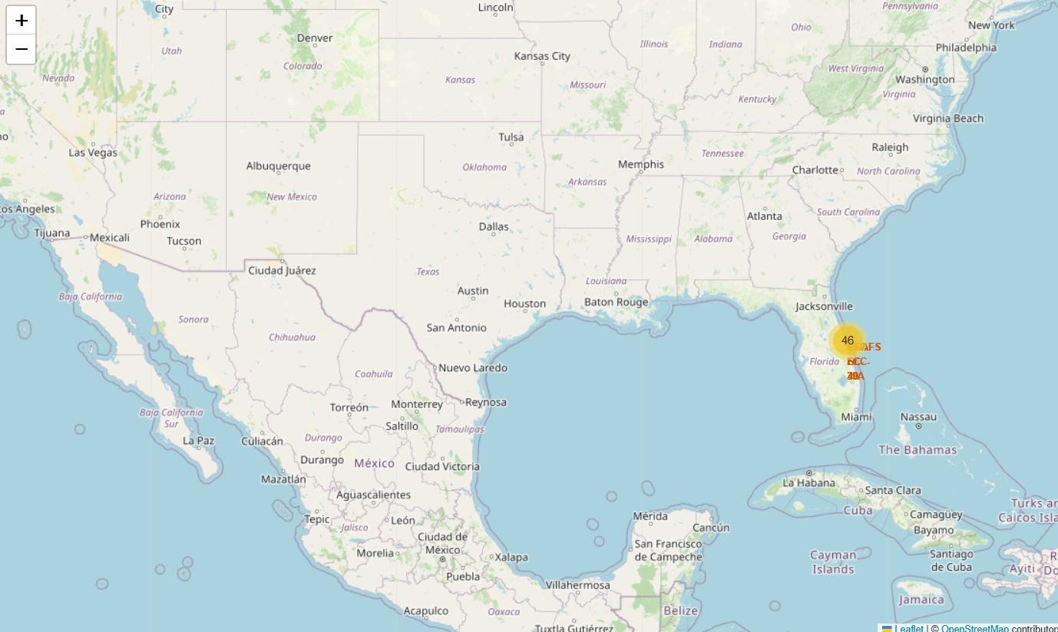
Success/failed launches for each site on the map

Slide 37
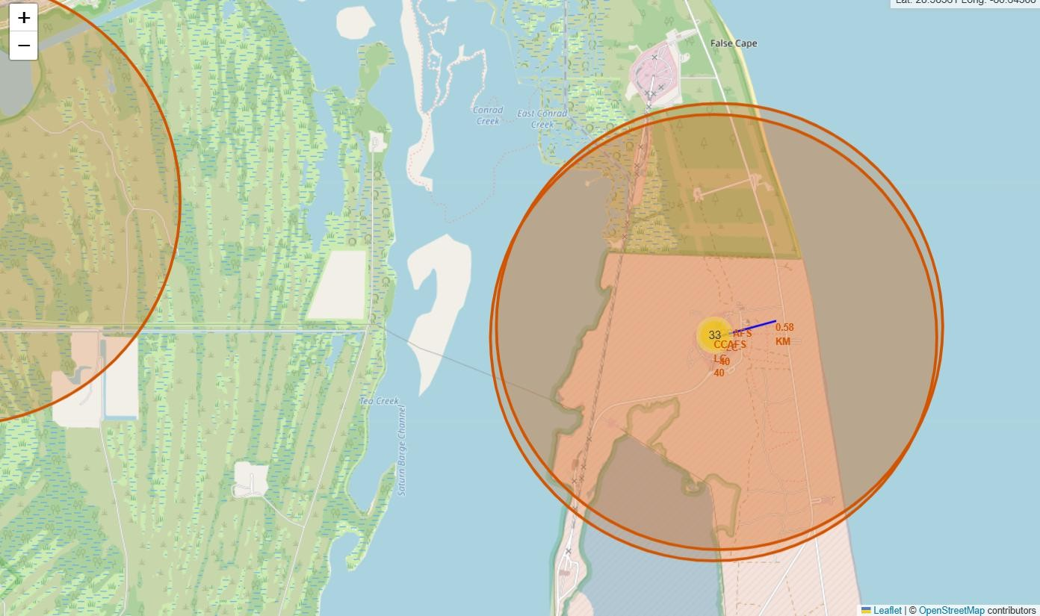
Distances between a launch site to its proximities

Slide 38

Section 4

Slide 39
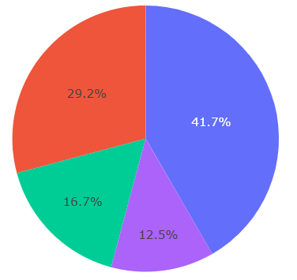
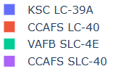
Total launches by site
The pie chart displays the distribution of successful launches This helps identify which sites have the highest number of successes and the success rate at each site.

Slide 40
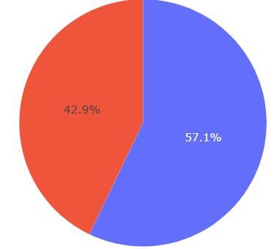
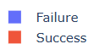
Success vs Failure for site CCAFS SLC-40
By comparing the two, you can quickly see the reliability of launches from this site. The chart shows a much larger portion for "Success“ than other sites, meaning CCAFS SLC-40 has a high success rate.
This information helps identify how dependable the CCAFS SLC-
40 site is for launches compared to others.

Slide 41
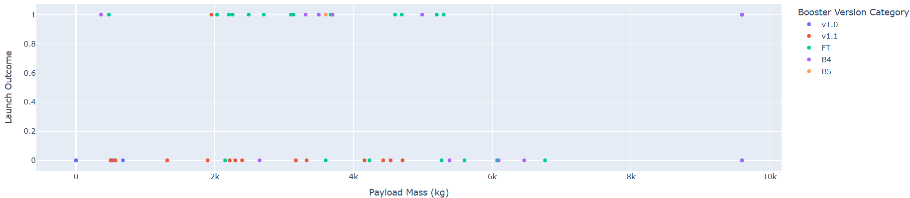
Correlation between Payload and Success for All Sites
You can see which booster versions were used for different payloads and outcomes.
The plot helps you visually check if heavier or lighter payloads are more likely to succeed or fail, and if certain booster versions perform better.

Slide 42

Section 5

Slide 43
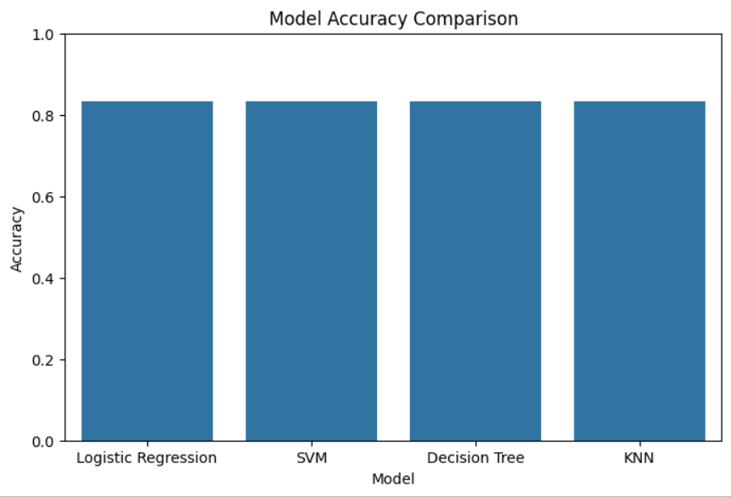
Classification Accuracy
All models performs the same on accuracy.

Slide 44

Confusion Matrix
The confusion matrix shows the model accurately identifies all actual landings but occasionally predicts a landing when there was none. There are no missed landings, but some false alarms for landings.

Slide 45
Conclusions
We built and compared four machine learning models to predict Falcon 9 first stage landings. After data preparation and hyperparameter tuning, all models performed reasonably well, with some differences in accuracy and recall. The best- performing model was identified using test metrics. This workflow highlights the value of model selection, tuning, and thorough evaluation for predictive analytics tasks.

Slide 46
Appendix
Include any relevant assets like Python code snippets, SQL queries, charts,
Notebook outputs, or data sets that you may have created during this project

Slide 47


